Slide 1

Multifamily “SREC”
US Commercial Credit Risk Portfolio Management
Quarterly Update
3Q15 ended September 30, 2015
U.S. Head of Credit & Market Risk

Slide 2
Table of Contents
Section | Topic | Slide No.
Executive Summary | Multifamily Highlights | 3
 | YTD 9/30/15 – Snapshot of Credit Metrics | 4
Credit Metrics | Credit Exposure Overview | 5
 | Credit Quality Metrics | 6 – 7
 | FEVE Trends | 8 – 9
 | Rating Distribution | 10 – 11
Exceptions | SCP Exceptions | 12 – 13
 | Policy and Underwriting Exceptions | 14
P&L | P&L | 15
Next Steps | Next Steps | 16
Appendix | Top 20
 | Concentration Limits and Usage
 | Risk ID
 | Strategic Commercial Plan 2015

Slide 3
3
Multifamily: Highlights
Positives | Concerns
Strong credit quality: Low delinquencies and non-accruals, WARR of 5.71 at 9/30/15. | Concentration in the Metro New York area, which may cause undue stress in case of regional downturn or natural disaster.
Well rated portfolio: 89% of the Portfolio is classified No FEVE while FEVE Grave accounts for less than 2%. Classified credits represent barely 1% of the Portfolio. | Continued accelerated run-off of the portfolio, resulting in below budget funded outstandings, partially due to a lack of new originations caused by highly competitive markets.
YTD ROA of 1.34% and Net Income of $99.7MM significantly exceed the budget of 0.98% and $72.1MM, favorably impacted by the release of loss provisions and higher net revenues. | Integration of the large Phoenix III portfolio considering the existing headcount constraints.
No open Regulatory, Internal Audit or Loan Review issues. | Concern that credit quality of newly originated deals may suffer given the competition and loosening market standards.
Note that updated Financials are required for reviews and such Financials are obtained only on an annual basis which may lead to delays in reviews. This issue is well-known and has previously been discussed with Monitoring. It is everyone’s preference to have updated reviews over adhering to “random” review dates.

Slide 4
4
Multifamily Snapshot
($ in Millions)
Note: Budget data as of 3/18/15, all other data as per Credit Metrics file.

Slide 5
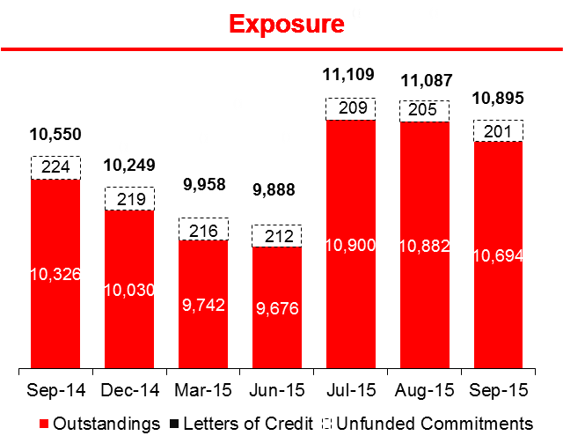
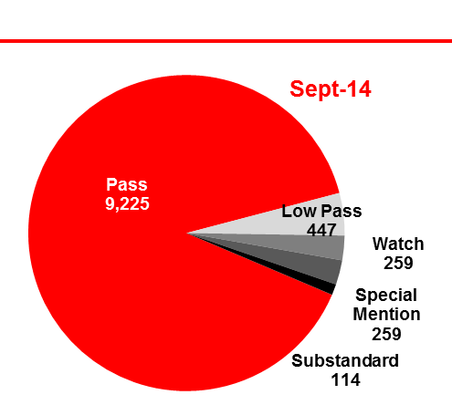
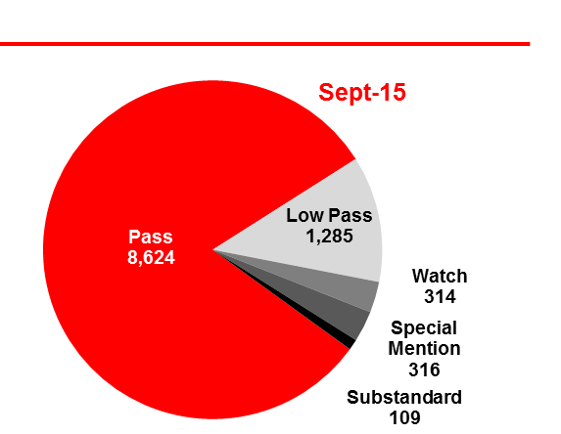
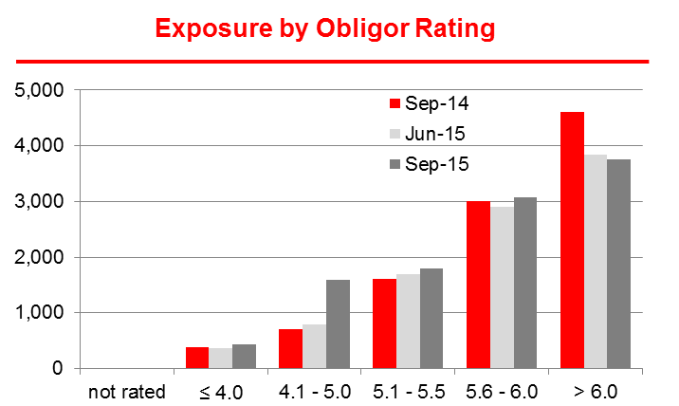
Multifamily: Credit Exposure Overview
($ in Millions)
The Fannie Mae portfolio purchase (“Phoenix III”) added $1.27BN in exposure in July (594 loans), making up for the rapid portfolio run-off caused by below-budget originations and a highly competitive market environment with tight market pricing.
To further illustrate the portfolio’s challenges in remaining at a stable size, exposure and outstandings increased by “only” $345MM and $368MM y-o-y, respectively.
Portfolio Quality continues to be stable and satisfactory. The “Exposure by Rating” distribution reveals a skew towards the higher rating categories, with 93% of exposure rated “Pass” and “Low Pass”, down from 94% in Sept-14, though the “Low Pass” contribution has increased noticeably from 4% to 12%. The deterioration is due to the recently implemented rating methodology change that rounds down to the nearest 0.5 SRR and the addition and ongoing review of Phoenix III.
Exposure by Regulatory Rating
90%
4%
2%
12%
3%
3%
81%
3%
1%
1%
Sources: The Exposure Chart on the top right is based on the 9/30/15 Credit Metrics report. The Exposure by ORR and Regulatory Rating is derived from Monitoring’s FEVE report as of 9/30/15.

Slide 6
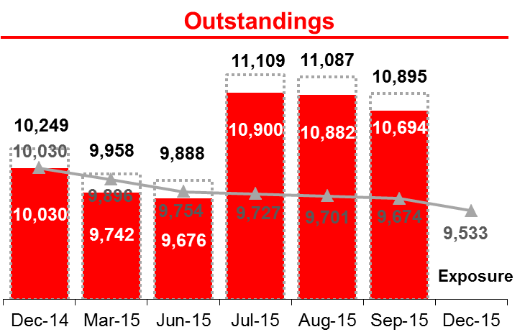
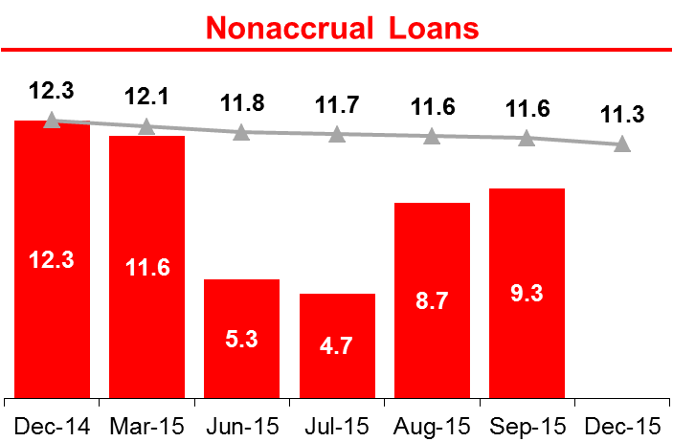
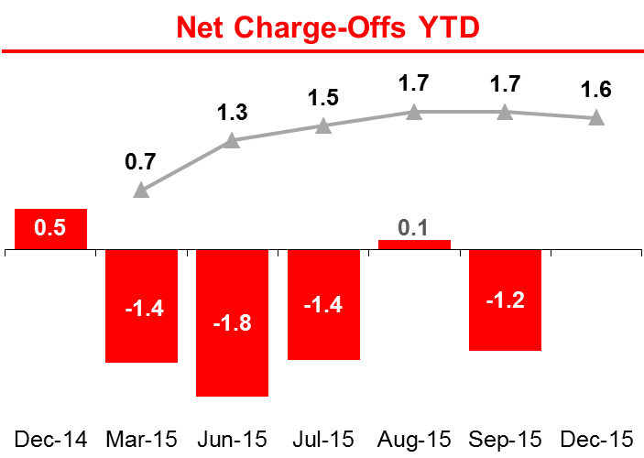
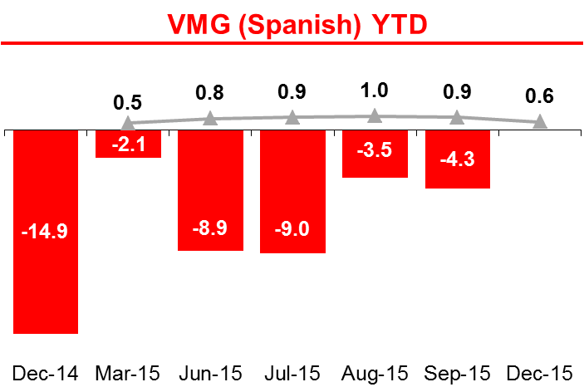
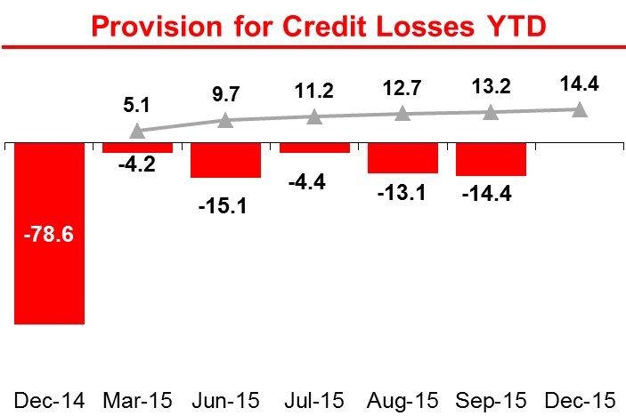
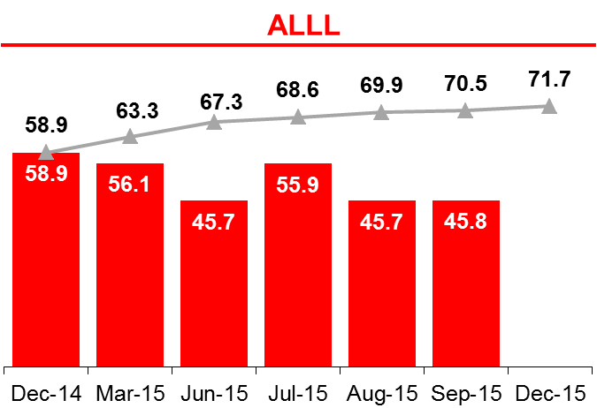
6
Multifamily: Performance vs. Budget
($ in Millions)
Multifamily outperforms its budget in every respect. There are no major credit concerns at this point.
The July closing of the $1.27BN Phoenix III portfolio acquisition improved outstandings and exposure significantly and will allow the business line to meet its budget for year-end despite the rapid portfolio run-off it has experienced.
The June decline in Nonaccruals is the result of the sale of the remaining Eric Stern asset, Congress Financial ($2.3MM), which was sold without UPB loss on 6/3/15. However, the increases in August/September stem from two Discretionary NPL for Adil Barakat Family Trust ($3.6MM) and Pineaire ($1.3MM), which are repurchased exposures from Fannie Mae (Phoenix III). This was offset by the foreclosure sale of B&H Management ($1.5MM NPL with $1.7MM Charge-Off).
Source: SBNA Solvency - Budget data as of 3/18/15.

Slide 7
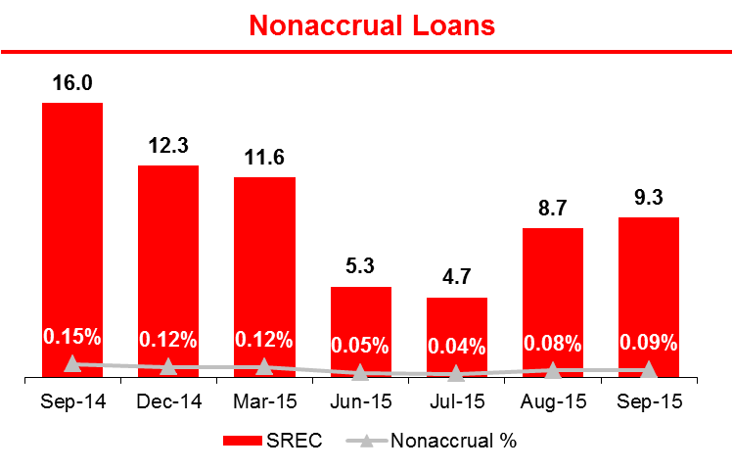
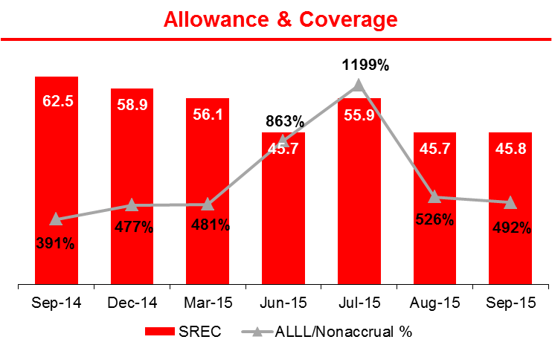
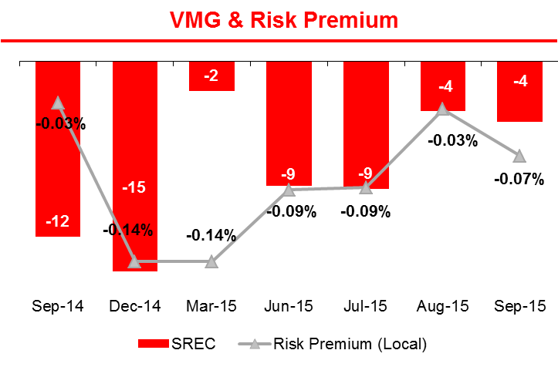
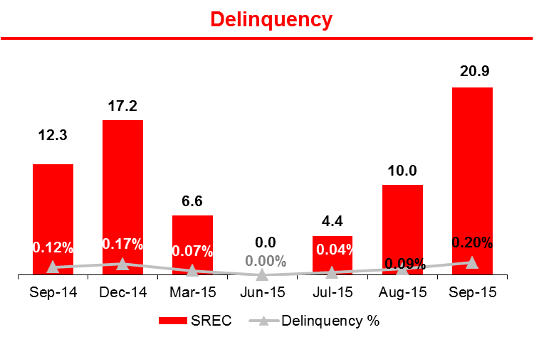
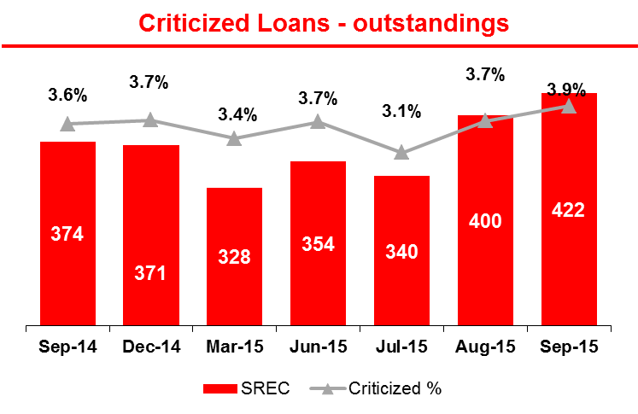
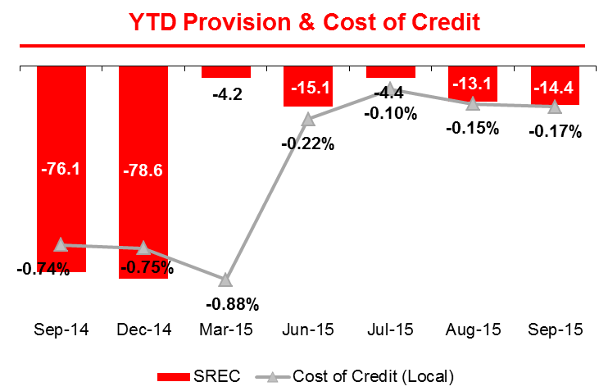
7
Multifamily: Credit Quality Metrics
($ in Millions)
SREC maintains its good credit quality, evidenced by the reasonable delinquency ratios and YTD Provisions for Credit Losses being negative, i.e. providing income. Non-Accruals continue to be very low, one of the reasons for the ALLL/Nonaccrual ratio to be elevated at close to 500%. In addition, a sizeable Management adjustment remains in place, although it was recently reduced.
Criticized outstandings were impacted by the additional criticized exposure out of Phoenix III and a few smaller downgrades to Special Mention.
Potential NPL entries for 4Q15 (all SRR 1.5/Extinguish): Renaissance Shopping Center ($8.9MM) located in Atlantic City; Glyndon Investments ($4.0MM, 81% LTV), an office building in Maryland; and Lenox 137 ($3.6MM, 51% LTV), a current but weakly performing multifamily building in Harlem. Rita Grace ($4.1MM), a Philadelphia building affected by a fire, was recently transferred to Workout, but remains on accrual status.
Source: SBNA Credit Metrics as of 9/30/15.
Note: Classified = Substandard + Doubtful + Loss.
Criticized = Classified + Special Mention.
Delinquency refers to 30+ days delinquent.
VMG = Change in Mora (Nonaccrual including L/Cs) + Net Charge-Offs
Cost of Credit = Rolling 12 months Provision / Avg 12 months Usage
Risk Premium = Rolling 12 months VMG / Avg 12 months Usage

Slide 8
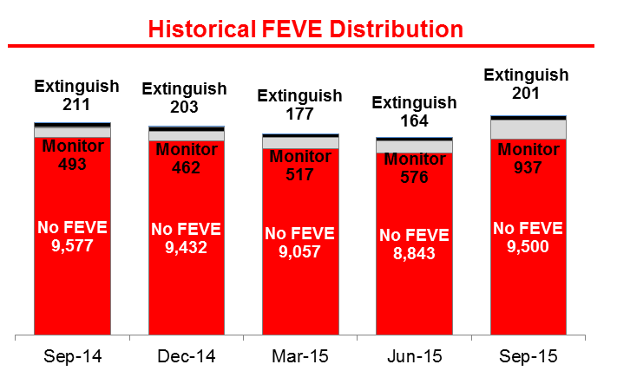
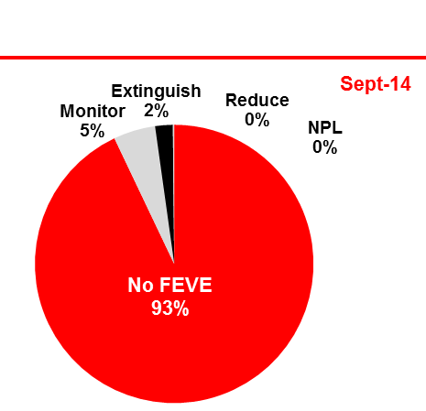
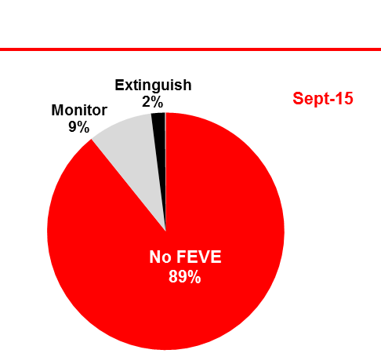
8
Multifamily: FEVE Trends
($ in Millions)
The quality of the Multifamily portfolio continues to be stable and satisfactory, with 89% of the Exposure rated “No FEVE”, down from 93% in the previous year, reflecting the strong Multifamily market especially in New York.
No significant* FEVE upgrades were reported during 3Q15.
Only 2% are in FEVE Grave.
Major FEVE Status Changes in 3Q15
Exposure by FEVE Rating
Source: FEVE Monitoring Report as of 9/30/15. Status changes only include exposure changes > $6MM.

Slide 9
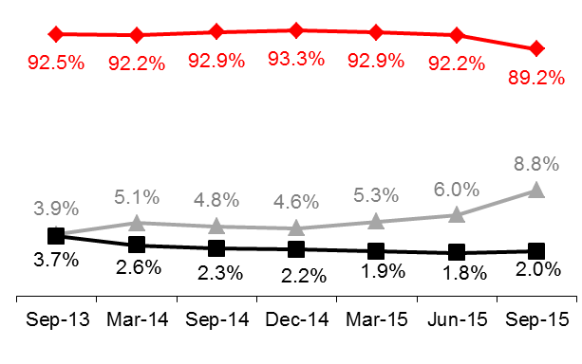
9
SREC: FEVE History
($ in Millions)
The quality of the Multifamily portfolio in terms of FEVE status continues to be satisfactory, in line with the strong Multifamily market in NY.
The slight uptick in “Monitor” credits is a result of newly added Phoenix III credits as well as more stringent monitoring.
Source: FEVE Monitoring Reports. All by Binding Exposure in SMM.

Slide 10
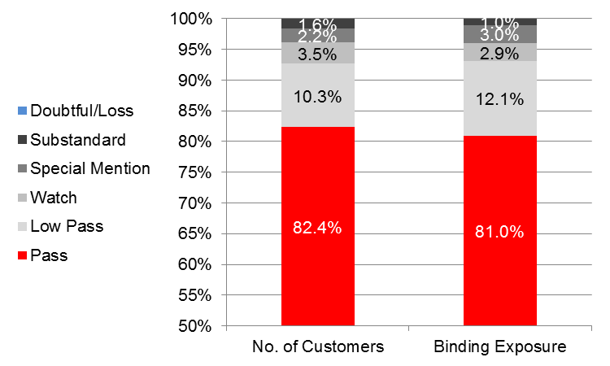
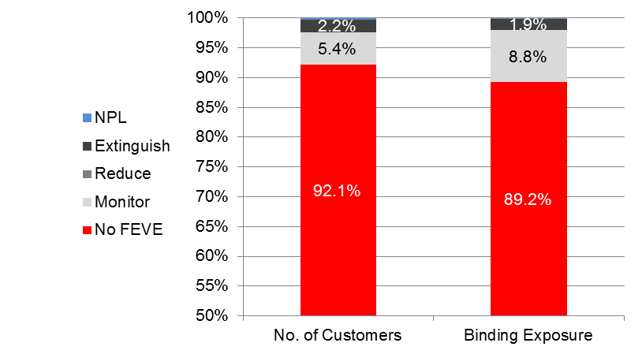
Exposure by Number of Customers
($ in Millions)
The FEVE and Regulatory rating distribution by customer count is quite similar than the distribution by Binding exposure. The ratings seems to be somewhat fairly distributed between the different sizes of customers; i.e. smaller customers have a similar likelihood of good credit ratings as larger customers.
Source: Monitoring FEVE report as of 9/30/15.

Slide 11
Rating Review: SRR vs. FEVE
($ in Millions)
Overall, ratings appear to be fairly distributed with a few exceptions, highlighted in the below charts.
The distribution of FEVE grades is concentrated in No FEVE, Monitor, and Extinguish with very little use of “Reduce” and no use of “Secure”. Especially for some of the lower ORR categories, a more diversified use of FEVE grades might be appropriate; however, it has been agreed with Monitoring that those classification are not applicable to Real Estate.
The perceived rating mismatches affect 88 customers (92 exposures) with total Binding Exposure of $159MM.
Source: Monitoring FEVE report as of 9/30/15.

Slide 12
SCP Exception Management
($ in Millions)
YTD 9/30/15, the portfolio has generated 66 loans with SCP exceptions out of 163 new loans originated. That translates into 41% of the total YTD Total Loan Production. However, not considering the 5.4 SRR threshold, exceptions only impacted 9 loans or 5.5% of YTD originations.
The exceptions tolerance level as per the SCP is 15% of budgeted new loan production in 2015 (referring to outstandings). If measured on a monthly pro-rata basis at a budgeted $1,250MM of new originations ($187.5MM allowable exceptions in 2015), the YTD exceptions exceed the tolerated $141MM by $219MM.
SCP Mandate
YTD 9/30/15 Material SCP Exceptions
Source: Madrid Exceptions report as of 9/30/15, produced by Multifamily CRE Credit Coordinator.

Slide 13
Multifamily: SCP Exceptions Detail
($ in Millions)
Of the 66 SCP exceptions, the minimum SRR of 5.4 was not met in 57 cases.
Of the remaining 9 facilities, another 6 facilities also did not meet the risk rating requirement in addition to DSCR, LTV or Interest-Only exceptions as highlighted below.
Note that the risk rating methodology for real estate loans has changed this year, rounding down to the nearest 0.5 risk rating; thus making any asset below a 5.5 risk rating a Madrid exception as per the original SCP definition. At an average 5.0 rating, the risk ratings of most of the “exceptional” loans are relatively close to the required threshold.
Source: Madrid Exception report as of 9/30/15, produced by Multifamily CRE Credit Coordinator.

Slide 14
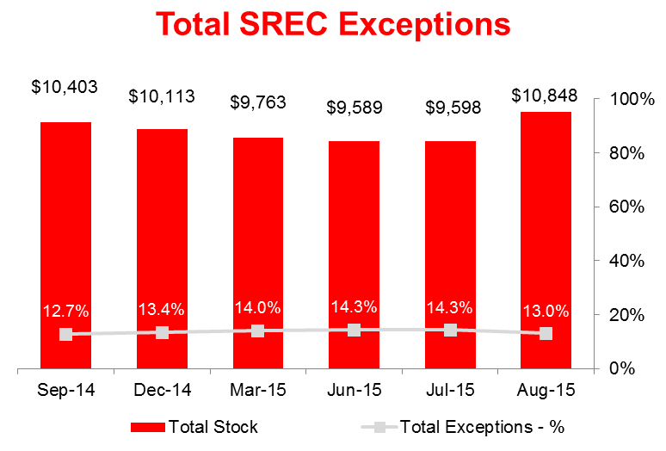
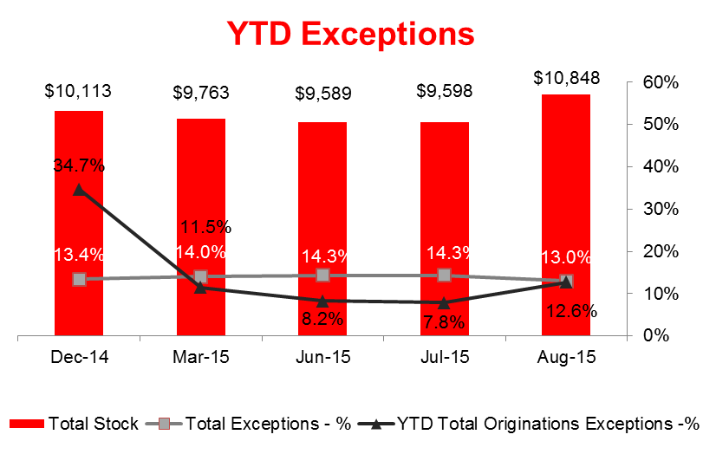
Exception Management
SREC - 14
($ in Millions)
SREC accounts for an acceptable amount of exceptions (17.2% of Bank Exceptions Binding Exposure) based on the size of the portfolio (26.6% of overall Binding Exposure).
More than 99% are related to Underwriting Guideline exceptions. Underwriting Guidelines exceptions were mostly related to Non-Compliance with Term, Maturity, Renewal and Amortization Guidelines, which affected 194 customers – i.e. 6.4% of SREC’s customer base – across 198 facilities.
The only Credit Policy exception is related to JC Broadway ($11.3MM), due to a FDICIA exception (LTV exceeds limit).
Source: CCMIS by Binding Exposure. “BANK” refers to SBNA without Retail, Small Business Banking, and runoff.
The overview does not include Obligor specific exceptions, such as “Sensitive Lending”. The Bank is in the process of cleaning up exceptions that are no longer exceptions as per the updated underwriting guidelines and cred it policy. The newly acquired exposure (Phoenix III) is not considered “new” exposure.

Slide 15
P&L Performance
Despite lower average outstandings for the YTD and tightening spreads, the portfolio generated higher-than-budgeted net revenue of $126MM YTD, a result of lower interest expense.
YTD “Other income” includes an earlier (recourse reserve release) and income associated with the Phoenix III purchase, although the overall result is seemingly less than expected.
YTD ROA of 1.34% exceeds the FY budget. The portfolio maintains strong credit quality. Recent risk rating policy updates have been implemented, including a rounding down of the risk ratings to the nearest 0.5, which may lead to an increase in general provisioning going forward.
Source: Actual results and Budget data were provided by Finance and Solvency. The amount of total provisions was tied to Management Control numbers.

Slide 16
Next Steps: SREC
ISSUE | PROPOSED ACTION PLAN | RESOURCES | Target Date
Portfolio is concentrated in highly rated credits (ORR > 6.0). | Review rating accuracy and rating standards. Consider timeliness of rating updates (FEVE), key performance indicators (DSCR, LTV, Occupancy), and other individual exposure parameter (obligor size, deal type, geography) in the analysis. | Monitoring | Ongoing
New Risk Rating Methodology | Continue to work with all parties on the testing and implementation of the new risk rating system. | Portfolio Management Credit | On going
Market Pricing vs. Credit Quality | Analyze the impact (if any) of tightening market spreads on the portfolio’s return. Use average terms by rating and run sample RoRAC calculations. | Portfolio Management | When new RoRAC calculator is available
Credit Quality of New Originations | Assess the portfolio’s credit quality on new originations. | Portfolio Management / Credit | Ongoing

Slide 17
APPENDIX
Top 20
Concentration Limits
Risk ID 2014
Strategic Commercial Plan 2015

Slide 18
Multifamily: Top 20
($ in Millions)
The Top 20 customers reflect less than 1% of the 2,900+ SREC customers, but account for 9.8% of SREC Binding Exposure and 1.1% of Total Bank exposure.
There was only one addition to the Top 20 composition during 3Q15: Taurus CD 184 Beverly Townhomes, which financed the acquisition of a 204-unit townhome complex in Beverly, MA with a tenor of five years (75% LTV, 1.23x DSC at 6.5%, 98% occupied).
The WARR of 5.6 indicates a good Pass rating, but the Top 20 includes two Special Mention assets: (1) Metropolitan Sutton, a Manhattan extended stay hotel to be converted to condominiums, recently upgraded to 3.5, and (2) 440-34 Mamaroneck Ave, an office building in Westchester county that is slowly stabilizing its tenant base. CP IV’s downgrade to 4.5 was the result of low occupancy at 66% and unstabilized cash flows as the building (located in New York, NY) is being renovated/reconfigured.
Source: Monitoring FEVE report as of 9/30/15.

Slide 19
APPENDIX – Top 20 Detail
($ in Millions)
Source: Monitoring FEVE report as of 9/30/15.

Slide 20
APPENDIX – Detail on Top 20 Special Mention Credits
Metropolitan Sutton Associates (SRR 3.5, upgraded from 2.7 in March-15)
• $40.0MM First mortgage secured by 17-story extended stay luxury hotel with 76 units. Midtown East, Manhattan.
• Originated in 2006 ($58MM), refinanced in 2011 with paydown to $40MM with a 5-year term and IO at L+1.75%.
Collateral value: $55.1MM as extended stay hotel (Mar-14) – LTV 73%.
History:
Continuous decline of NOI in 2012/13.
Stressed DSCR insufficient, but actual DSCR 1.57x (2014)
Borrower did update building (new safety codes) which led to a restriction of stays to more than > 30 days only. Loss of income.
Current Situation
Asset is “transitional” with plan to convert the property into condominiums for sale with a capital injection of $8.2MM for upgrades.
- Condo sale launching in the fall with an estimated $150 million proceeds (LTV 29%).
Loan remains current. The recent upgrade was due to the sponsor’s commitment and equity contribution.
Mitigant of Risk: Calsters is an 80% investor.
Action Plan:
Close monitoring of budget and marketing plan and occupancy
Monitor sale of condo units and Follow up with borrower regarding planned payoff date in 11/2016.
440-34 Mamaroneck Ave (SRR 3.4, upgraded from 2.7 in Jun-15)
• $37.4MM First mortgage secured by a 238K SF, 5-story, Class A office Building in Harrison, NY (Westchester County).
• Originated in 2011 with 7-year term, interest-only for 2 years, then amortizing on 30-year schedule.
• Collateral value (Jun-15): $54.2MM as-is, rating 2 (good condition).
• LTV of 68% as per 6/2015 appraisal.
History:
Drop in occupancy from 97% to 72% as Bank of NY vacated premises in May-13 and other tenants renegotiated leases (10-2014)
Stressed DSCR insufficient (since 2/2014)
Current Situation
Occupancy up to 81%, improved cash flows. DSCR remains at < 1.00x stressed due to concessions.
Loan remains current
Action Plan: Close monitoring of leasing activity and stabilizing cash flow.

Slide 21
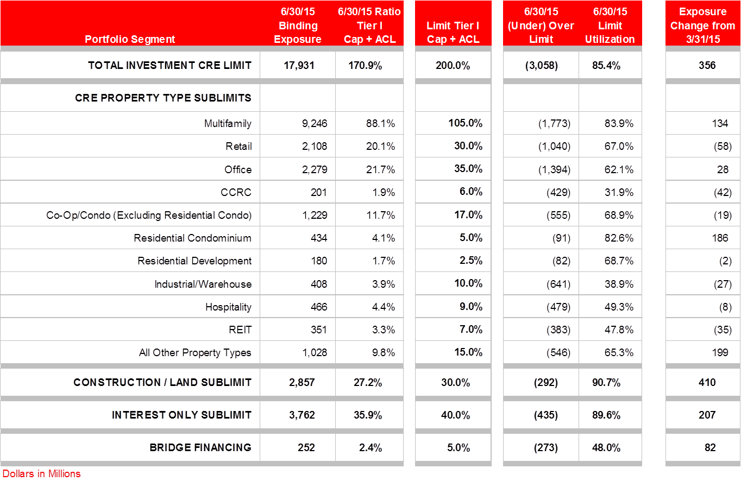
Commercial Real Estate Concentrations
Data: As of 6/30/15 as updated concentration levels are currently in the process of being approved.

Slide 22
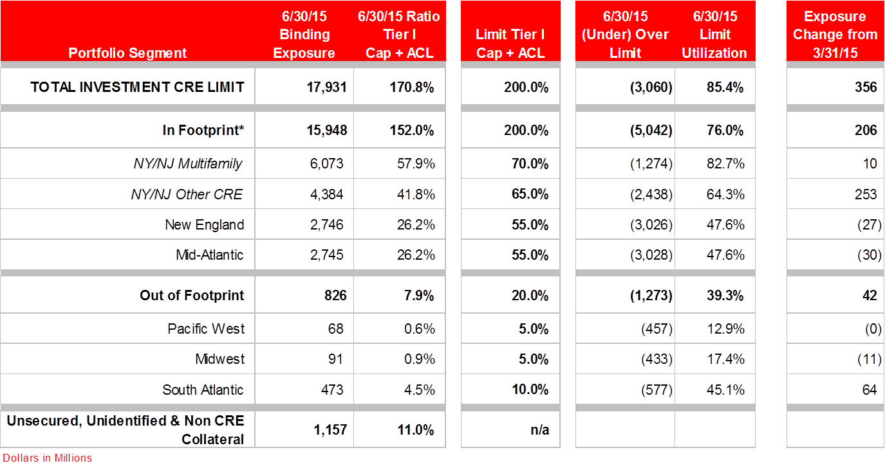
Commercial Real Estate Geographic Concentrations
Below is a break down of CRE by geography, 80% of the portfolio is located in footprint, 20% is located out of footprint (5% - Pacific West, 5% - Midwest, 10% - South Atlantic). The loans within the footprint appear to well diversified across the different markets.
Data: As of 6/30/15 as updated concentration levels are currently in the process of being approved.

Slide 23
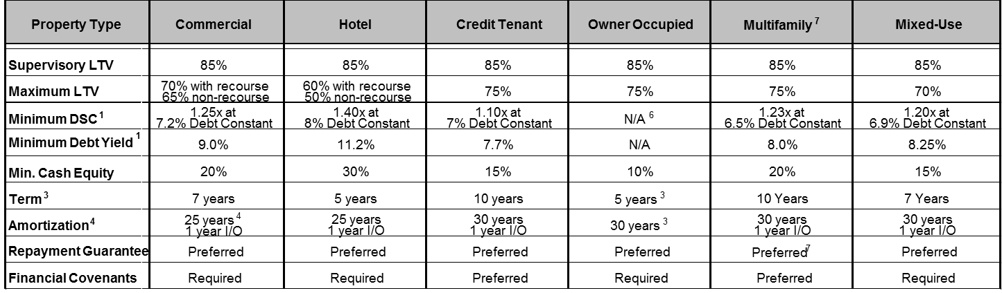
23
Multifamily: Strategic Commercial Plan
($ in Millions)
The following parameter were outlined in the SCP approved for 2015:
All transactions to follow SBNA approval process per credit policy. Credit Policy and underwriting guidelines will be approved locally as credit policy allows. Transactions beyond the delegated authority levels will require global approval.
Up to $75MM of final hold.
One Obligor Exposure: max. $150MM (10% allowance for single deal)
Strategy
Defend SAN US position in NY Metro
Deepen cross-sell and introduce floating rate strategy with SWAP
Expand into New England markets through direct origination and other non-Meridian intermediaries
Maintain credit quality; i.e. NPLs < 0.2%, NCOs < 0.05%.
Target Profitability
2015 Revenue of $159MM
Increase fee based income through an increase in floating rate loans with a swap or cap with our GBM partners.
Increase cross-sell opportunities through cash management groups.
Underwriting
Guidelines –
Term Lending

Slide 24
Risk ID and Assessment (1 of 2)
Risk ID | Risk Event | Risk Description | Control
9.2 Strategic Risk | Breach of contract between Santander and Meridian Capital due to either of the parties not meeting contract requirements | Loss of pipeline activity and reputational damage | -Weekly internal meetings - Periodic meeting between the Bank and Meridian -Tracking of the originations on the weekly basis -Upper management meetings held couple of times a year
9.7 Strategic Risk | -Agility of the business to respond to the changes in the Market without impacting the budget and risk appetite | Negative impact on business opportunities to generate income | -Meetings to monitor the policy -Monthly Exception reporting - Pipeline reports
9.14 Credit Risk | Customer is unable to remain current on loan due to market factors: - High unemployment rate - Higher vacancy rate - Lower rent growth - Poor management | Risk of loss linked to default due to market conditions | - Annual reviews -Delinquency meetings - Monthly reviews of KPI's -Adhering to policy and procedures
9.84A Credit Risk | Higher than average defaults due to -High concentration in a geography/ sector/clients which experiences an economic downturn - Overweighing the resources on a particular sector/region/clients - Risk highly concentrated geographically - sensitive to macro environment (unemployment/housing prices/natural disasters) | Risk of loss due to lack of diversification: Too much Real Estate, hence inability to diversify portfolio Unemployment/housing prices/natural disasters Risk of loss due to lack of diversification | - Sector limits -Regular monitoring of the portfolio; - Concentration limits
9.85A Credit Risk | - Changes in the value of the collateral due to macroeconomic factors, consumer behavior, sector specific regulation, bad media coverage etc. | Risk of loss due to changes in changes in collateral values | - Internal valuation of the assets (Internal reviews) on a ongoing basis - Adequate covenants
9.86A Credit Risk | Customers are unable to refinance loans due to the following: -Rate changes due to FED actions or market conditions | Market indicators impact customer's ability to refinance resulting in financial loss | Maturity schedules, monitoring of customers maturities. Monitoring of overall credit market conditions. Established workout team.
9.87A Credit Risk | Changes in the marketplace causing non-payment or default events for a high number of obligations, overwhelming current workout staff and systems | - Risk of not detecting the faulty customers - Risk of detecting these customers and having insufficient resources at hand | - Regular monitoring

Slide 25
Risk ID and Assessment (2 of 2)
Risk ID | Risk Event | Risk Description | Control
8.18 Credit Risk | - Decline in value of collateral used by current market conditions ' - Lack of insurance on collateral we originate ' - Act of nature - damaged collateral or total loss of collateral due to natural disaster e.g. hurricane | - A decline in asset values could potentially result in lower profitability in the event of a foreclosure, repossession, or REO sale; ' - Risk of loss due to lack of insurance on collateral base | - Forced place insurance - insurance follow policy and procedures Allow for decreased Market cushion in underwriting value per regulations and policy. Annual re-assessment of collateral value.
8.19 Credit Risk | - Changes in the value of the collateral due to macroeconomic factors, consumer behavior, sector specific regulation, bad media coverage etc. | Risk of loss due to changes in changes in collateral values | - Internal valuation of the assets (Internal reviews) on a ongoing basis - Adequate covenants
8.2 Credit Risk | Higher than average defaults due to -High concentration in a geography/ sector/clients which experiences an economic downturn - Overweighing the resources on a particular sector/region/clients - Risk highly concentrated geographically - sensitive to macro environment (unemployment/housing prices/natural disasters) | Risk of loss due to lack of diversification: Too much Real Estate and not enough C&I to diversify portfolio (e.g.. tech & health care). Unemployment/housing prices/natural disasters Risk of loss due to lack of diversification | - Sector limits -Regular monitoring of the portfolio; - Increasing presence in under-penetrated prime NY and DC markets - Concentration limits
8.23 Credit Risk | Changes in the marketplace causing non-payment or default events for a high number of obligations, overwhelming current workout staff and systems | - Risk of not detecting the faulty customers - Risk of detecting these customers and having insufficient resources at hand | - Regular monitoring
8.25 Credit Risk | - Sponsor of construction project becomes illiquid (over-runs for completion occur) ' - Excess supply of new buildings in the market | - Completion Risk: Risk of loss due to loss of source funding; ' - Inability to lease or buy properties that the Bank was involved in, leading to potential loss | Ongoing review of construction project thru internal and external parties
8.57 Credit Risk | Failure to adhere to credit analysis process resulting in poor credit decisions and variance between pricing and risk. | Risk of loss due to increased PD | Past Due Reporting, on-going reviews
8.93 Credit Risk | Inappropriate exceptions and mentoring to established policy, and credit underwriting metrics leading to increased PD's. | Risk of loss due to higher PD's; higher reserves/provisions | Ongoing reporting, underwriting requirement of a detailed, clear explanation of noted exceptions. Continuing investment in the development of exception reporting.
8.88 Credit Risk | Non adherence to controls within documentation or approval. (ex. Cash sweep required from excess monthly income) | Risk of deteriorating of in asset quality, increased provisions, increased Potential Loss, weakened course of dealing. | .Partnership with Risk and Line to manage loan as approved

Slide 26
Notes:
26

